Slide 1



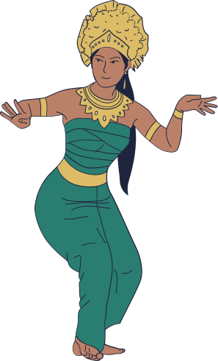

HACK KRMU 5.0
HACK KRMU 5.0
PROBLEM STATEMENT ID :
ENABLING PRECISE LEARNING OF CLASSICAL INDIAN DANCES THROUGH REAL-TIME FULL-BODY MOVEMENT DETECTION.
OPEN INNOVATION — Theme 2 (AR/VR)
TEAM NAME :
AGARBATTI
TEAM ID :
HK-109
TEAM MEMBERS :
Srishti Gupta , Dhruv Kataria
Piyush Negi , Aksh Rastogi

Slide 2


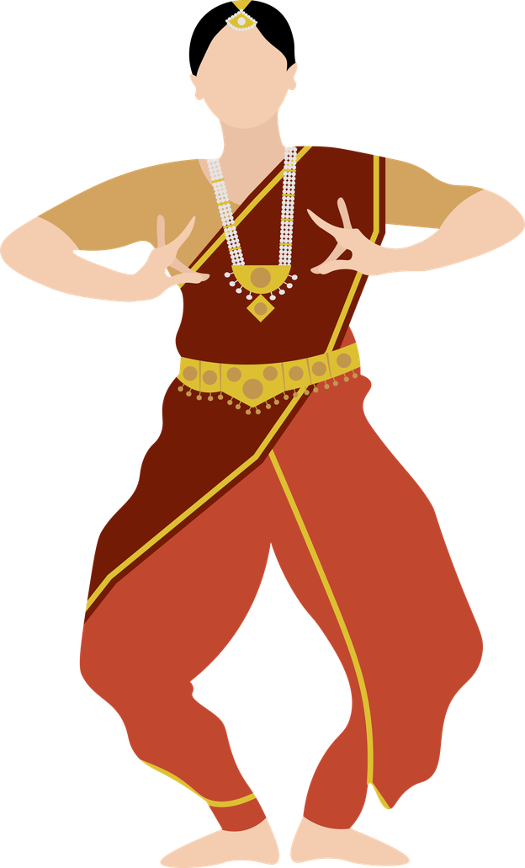
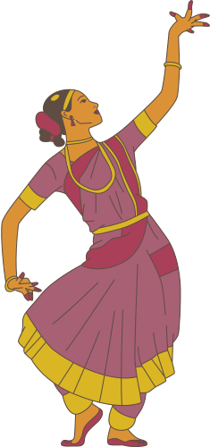
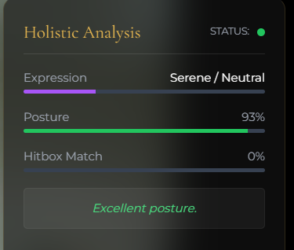
HACK KRMU 5.0
PROBLEM STATEMENT AND SOLUTION
CLASSICAL INDIAN DANCE DEMANDS PRECISE POSTURE, MUDRAS & FOOTWORK. LEARNERS WITHOUT EXPERT GUIDANCE STRUGGLE TO SPOT & FIX MISTAKES IN REAL-TIME → SLOW PROGRESS + INCORRECT TECHNIQUE.
Kaladrishti –– AI-powered self-learning platform for Indian classical dance -
Real-time posture, expression & hitbox feedback using browser-based AI
Beginner → Advanced levels with progressive skill sets
Instant correction & scoring: Posture (e.g. 93%), Expression, Position Accuracy
Accessible anywhere – no guru needed

Slide 3
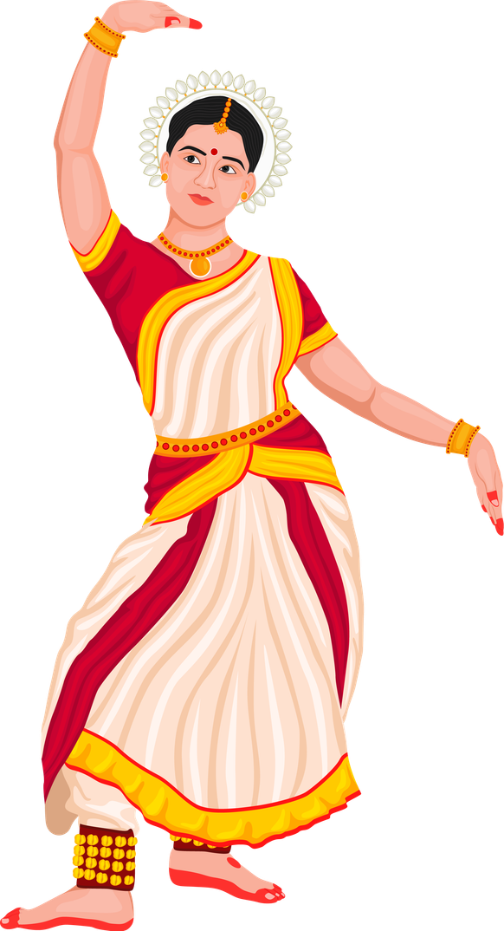
HACK KRMU 5.0
SOLUTION FLOW
1.
CAPTURE & DETECT: RECORD DANCE AND EXTRACT FULL-BODY KEYPOINTS
2.
PROCESS & ANALYZE: CLEAN DATA AND EXTRACT MOVEMENT FEATURES
3.
AI POSE MATCHING: COMPARE MOVEMENTS WITH CLASSICAL KARANA DATABASE
4.
3D VISUALIZATION: DISPLAY RECONSTRUCTED REFERENCE POSES
5.
REAL-TIME FEEDBACK: HIGHLIGHT ERRORS AND SUGGEST CORRECTIONS

Slide 4

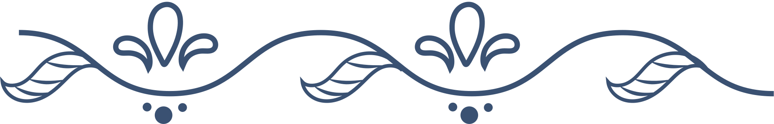
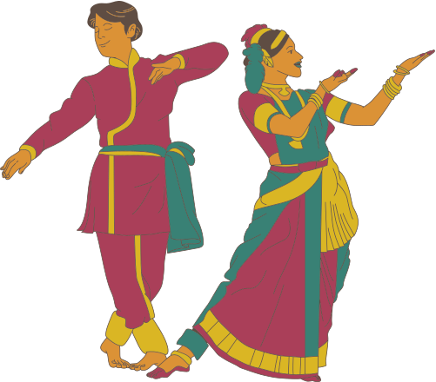
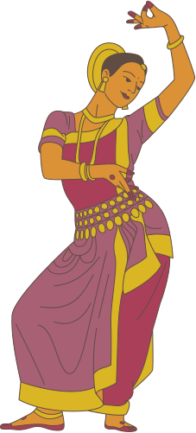
HACK KRMU 5.0
TECHNOLOGIES & APPROACH USED
CORE TECHNOLOGIES:
PROCESSING & TOOLS:
The system is built using HTML, CSS, and JavaScript for a fully web-based interface. MediaPipe is used for real-time body pose detection, while TensorFlow supports pose recognition and analysis directly in the browser. Current website is deployed using Vercel
Live camera input is processed by OpenCV to extract body landmarks, which are then analyzed to recognize different poses. The entire pipeline runs in a standard web browser, requiring no additional hardware.

Slide 5
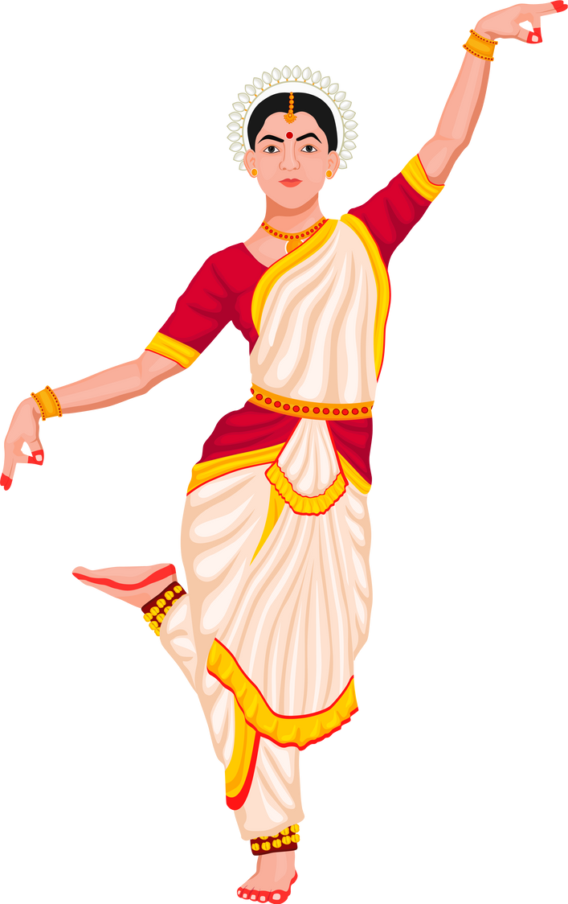
HACK KRMU 5.0
UNIQUENESS & SPECIAL FEATURES
FULL-BODY TRACKING: DETAILED DETECTION OF HAND GESTURES, FOOT POSITIONS, AND TORSO ALIGNMENT.
REAL-TIME FEEDBACK: INSTANT INDICATION OF WRONG MOVEMENT OR POSTURE DURING PRACTICE SESSION.
CLASSICAL DANCE FOCUS: CUSTOMIZED MODELS FOR INDIAN DANCE STYLES LIKE BHARATANATYAM, KATHAK, ODISSI.
PROGRESS DASHBOARD: TRACK IMPROVEMENTS OVER TIME WITH VISUAL ANALYTICS.
GAMIFIED SCORING: ENCOURAGE ENGAGEMENT WITH PERFORMANCE SCORES AND MILESTONE BADGES.[FUTURE ASPECT]

Slide 6
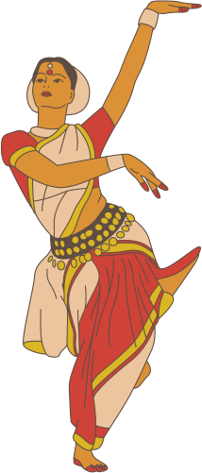
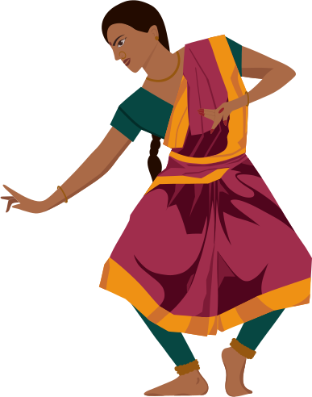
HACK KRMU 5.0
FEASIBILITY & CHALLENGES
CHALLENGES:
FEASIBILITY
Occlusions - Traditional costumes & flowing garments interfere with detection
Environmental variance - Lighting, camera angles & background changes affect accuracy
Data dependency - Limited diverse annotated datasets for Indian dance poses/mudras
Built with open-source tools (MediaPipe Holistic)
Runs entirely in-browser → low cost, accessible on any device
Scalable for Indian classical dance forms

Slide 7
HACK KRMU 5.0
REFERENCES & TOOLS
Research & References:
MediaPipe Holistic (Lugaresi et al., 2019)
AI for Bharatanatyam Pose/Mudra Recognition (Scientific Reports 2024, IEEE/arXiv 2023–25)
Computer Vision in Indian Classical Dance
Cultural Heritage Preservation (UNESCO ICH principles)
Responsible & Human-Centered AI (Google RAI Practices)
Tools Used
MediaPipe (pose/face/hand tracking)
Tailwind CSS + Google Fonts
JavaScript + Canvas / MediaRecorder
LocalStorage + Mock MongoDB
GitHub
VS Code
Vercel

Slide 8
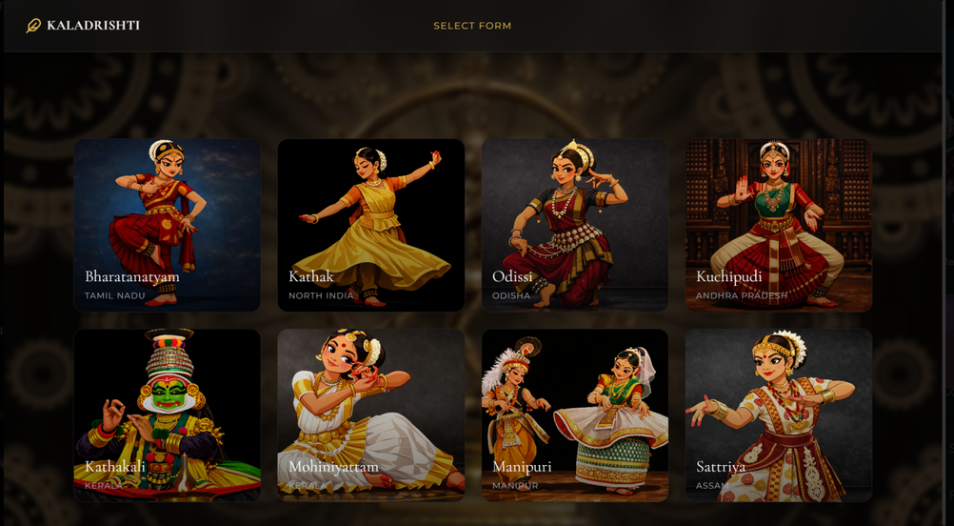
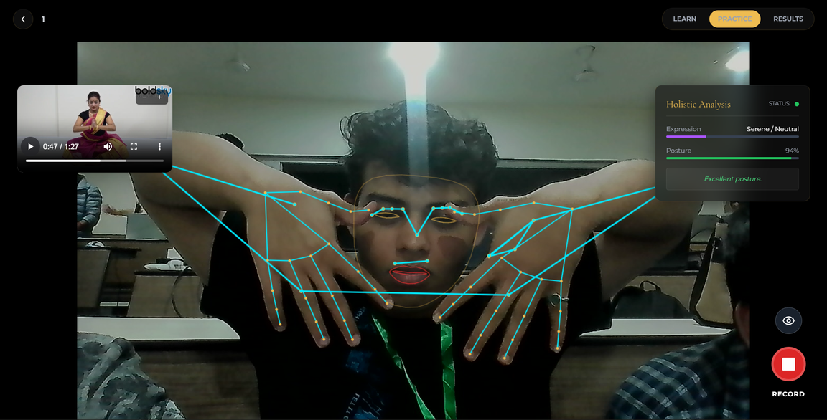
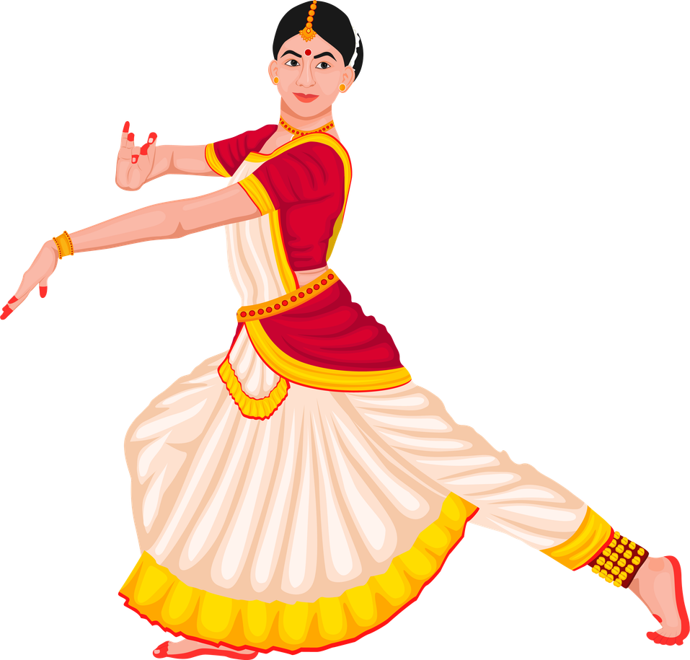
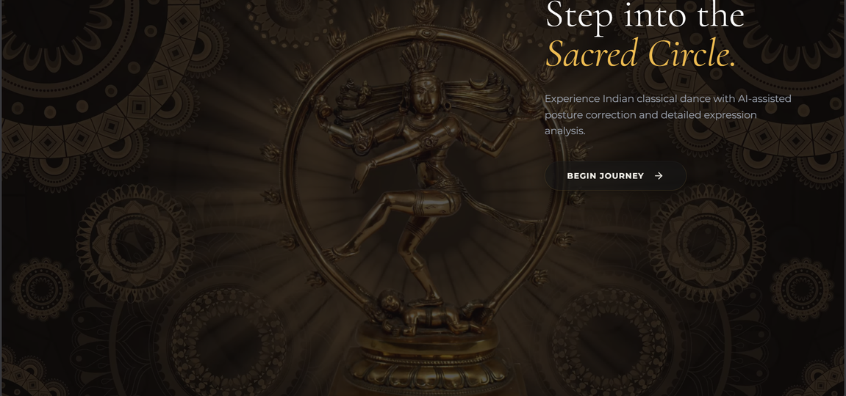
VISUAL REPRESENTATION
HACK KRMU 5.0

Slide 9

THANK YOU

